Slide 1

Neuroscience in the Classroom
Dan Conley
Director of In-School AP

Slide 2
Objectives
Outline neuroscience of brain development
Explore reactions to threat and hostility
Link to emotion coaching session next week
Reflection…
What pushes your buttons and why?

Slide 3
Meet your brain…

Slide 4
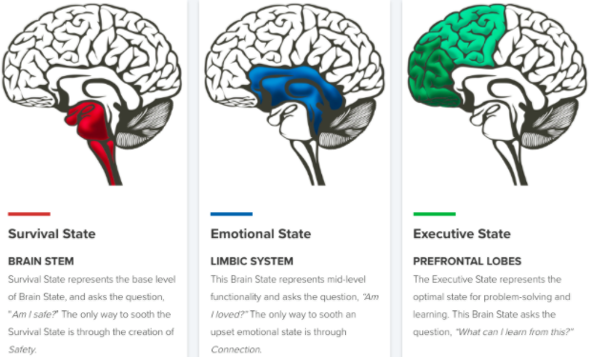
The Brain Stem
Our life support centre
Regulates pulse, breathing, blood pressure
Develops first, mature by birth

Slide 5
The Limbic System
The seat of our emotion
Relational connection and attachment
Matures by 10-13 years old

Slide 6
The Cortex
Home of uniquely human capabilities
Logical reasoning, planning, inhibiting
Fully matures by 25 years old

Slide 7
Meet your body…

Slide 8
Take yourself back to a major and heated conflict you had with someone. Try to visualise the place you were in and the events as clearly as possible. Try to inhabit your body and experience it again.

Slide 9
How your behaviour change?
How did your language change?
How did your body language change?
How angry were you (scale from 1 to 10)?

Slide 10
Agree or Disagree?
Later, I thought of things I wished I’d said
I was distracted for over an hour afterwards
It took at least an hour for my body to relax

Slide 11
Emotion Coaching…

Slide 12

Emotion Coaching
Lookout System
Brain pathways that constantly monitor our environments and other people to ensure we are ready to respond to threats and
danger (Porges, 2011).
Lookout
System

Slide 13
Emotion Coaching
Social Engagement
Drives us to engage in more socially appropriate behaviour, think more clearly, learn new skills and problem-solve
(Siegel and Bryson, 2012)
Lookout
System

Slide 14
Emotion Coaching
Stress Response
Reaction to threat / danger
Fight, flight, or freeze
Higher reasoning shuts down
Heart / breathing rate ↑
(Selye, 1956)
Lookout
System

Slide 15
Emotion Coaching
Your Argument
What was the threat?
Fight, flight, or freeze
Higher reasoning shuts down
(Things you wished you’d said?)
Heart / breathing rate ↑
Lookout
System

Slide 16
Emotion Coaching
Early Trauma
Major / chronic activation
‘Primes’ the lookout system
Becomes over-sensitised
Hypervigilance
Behavioural dysregulation
Lookout
System

Slide 17
Video
The Neurosequential Model

Slide 18
Emotion Coaching
Teaching aims here

Slide 19
Emotion Coaching
Emotion Coaching aims here

Slide 20
Emotion Coaching
Reason
Relate
Regulate
An Incident in School: BBC3

Slide 21
Emotion Coaching
Stress Response
Assertive body language
Blocking exits / cornering
Disinterest / dismissive
Verbal threats / challenges
Lookout
System

Slide 22
Emotion Coaching
Reason
Natural curiosity
Problem-solve together
Validate / label feelings
But how do you regulate a student:
In a busy class of 30?
Around the school?
Relate
Regulate

Slide 23
Classroom Strategies
Reason
Predictable routines
Countdown timers
Minimise noise
Crouch beside
Natural curiosity
Validate feelings
Problem-solve together
Paper clips & blu-tack!
Time out & check-in
Box breathing (4,4,4,4)
Relate
Regulate

Slide 24
Strategies Around School
Reason
Relatable approach
Calm voice
Stand beside
Let’s walk
Natural curiosity
Validate feelings
Trusted adult check-in
Problem-solve together
Allow an exit route
Box breathing (4,4,4,4)
Relate
Regulate

Slide 25
Objectives
Outline neuroscience of brain development
Explore reactions to threat and hostility
Link to emotion coaching session next week
Reflection…
What pushes your buttons and why?

Slide 26
Neuroscience in the Classroom
Dan Conley
Director of In-School AP
daniel.conley@coopacademies.co.uk

